Slide 1

6th Grade Accelerated Math
Unit 14, Lesson 1 Translating Real-World Written Descriptions into Algebraic Inequalities Volume 2, pg. 335

Slide 2


Benchmark
MA.6.AR.1.2
Translate a real-world written description into an algebraic inequality in the form of x > a, x < a, x ≥ a, or x ≤ a. Represent the inequality on a number line.
volume 2, pg. 335

Slide 3
Integrated Mathematical Thinking and Reasoning Standards
MA.K12.MTR.1.1 Actively participate in effortful learning both individually and collectively.
MA.K12.MTR.4.1 Engage in discussions that reflect on the mathematical thinking of self and others.
MA.K12.MTR.5.1 Use patterns and structure to help understand and connect mathematical concepts.
MA.K12.MTR.6.1 Assess the reasonableness of solutions.
MA.K12.MTR.7.1 Apply mathematics to real-world contexts.
volume 2, pg. 335

Slide 4

Learning Targets
I can translate a written description into an algebraic inequality.
I can represent an inequality on a number line when given a written description of a real-world context.
volume 2, pg. 335

Slide 5

Warm-Up
volume 2, pg. 335

Slide 6
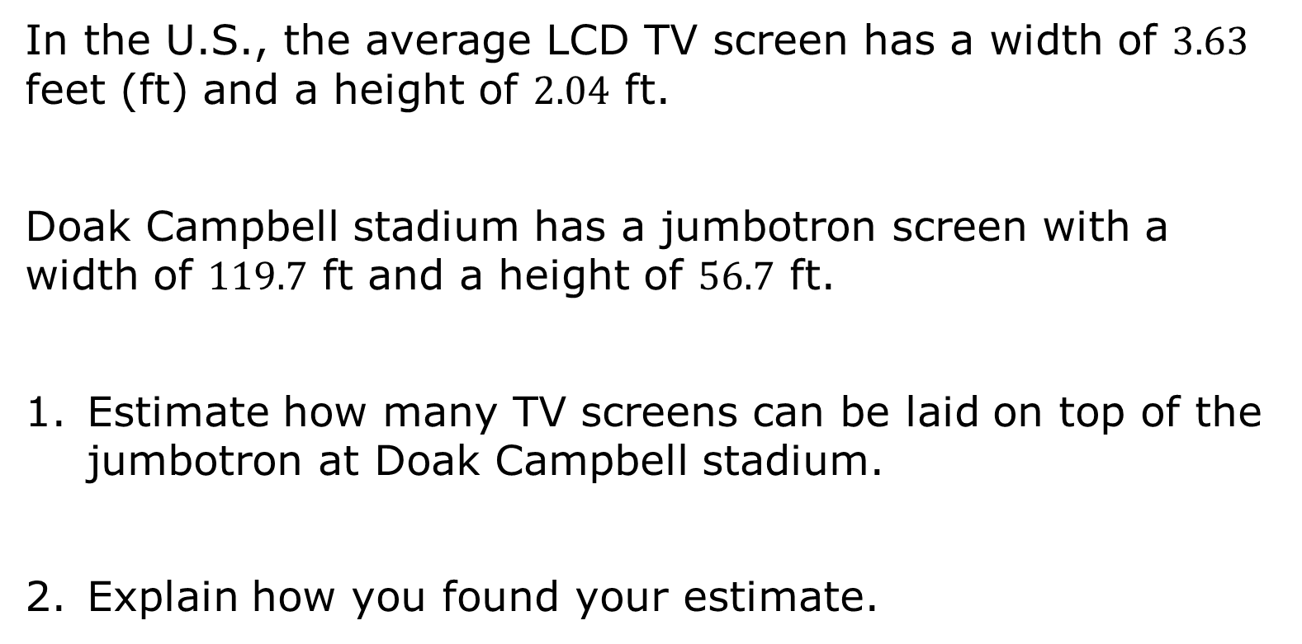
14.1.1 Warm-Up: Jumbotron Estimation
In the U.S., the average LCD TV screen has a width of $3.63$ feet (ft) and a height of $2.04$ ft.
Doak Campbell stadium has a jumbotron screen with a width of $119.7$ ft and a height of $56.7$ ft.
Estimate how many TV screens can be laid on top of the jumbotron at Doak Campbell stadium.
Explain how you found your estimate.
volume 2, pg. 335

Slide 7

Exploration
volume 2, pg. 336

Slide 8

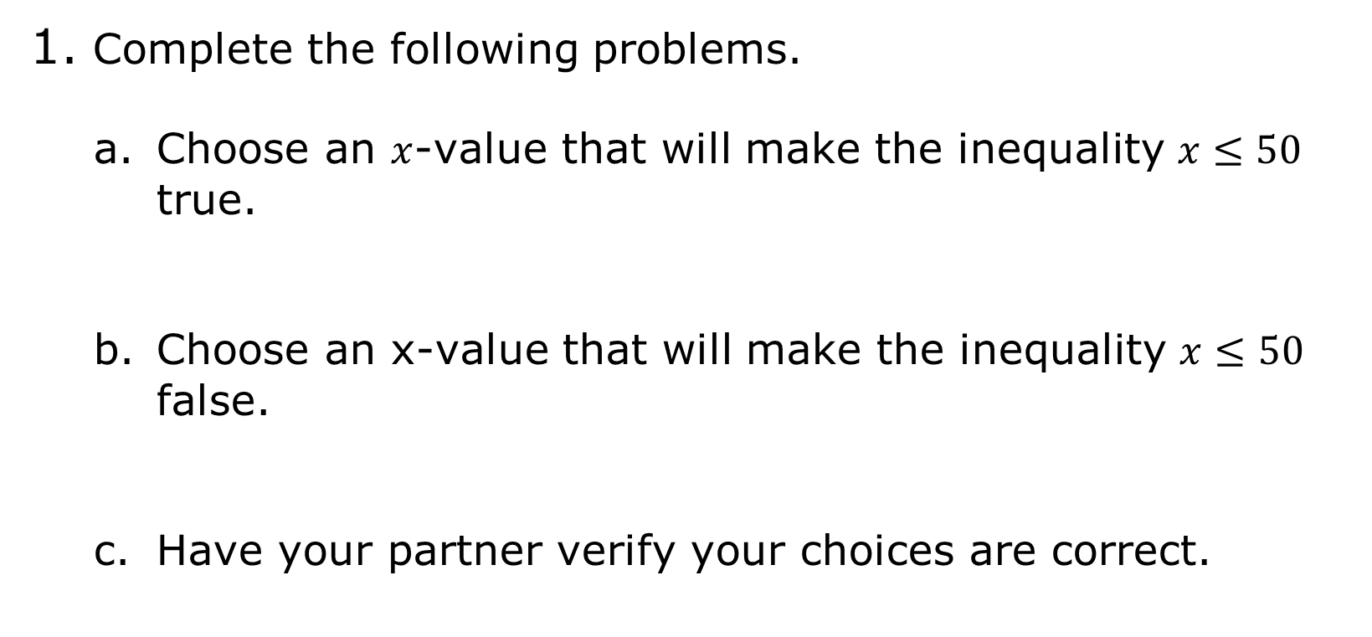
14.1.2 Exploration: Representing Inequalities on a Number Line
Complete the following problems.
Choose an $x$-value that will make the inequality $x≤50$ true.
Choose an x-value that will make the inequality $x≤50$ false.
Have your partner verify your choices are correct.
volume 2, pg. 336

Slide 9
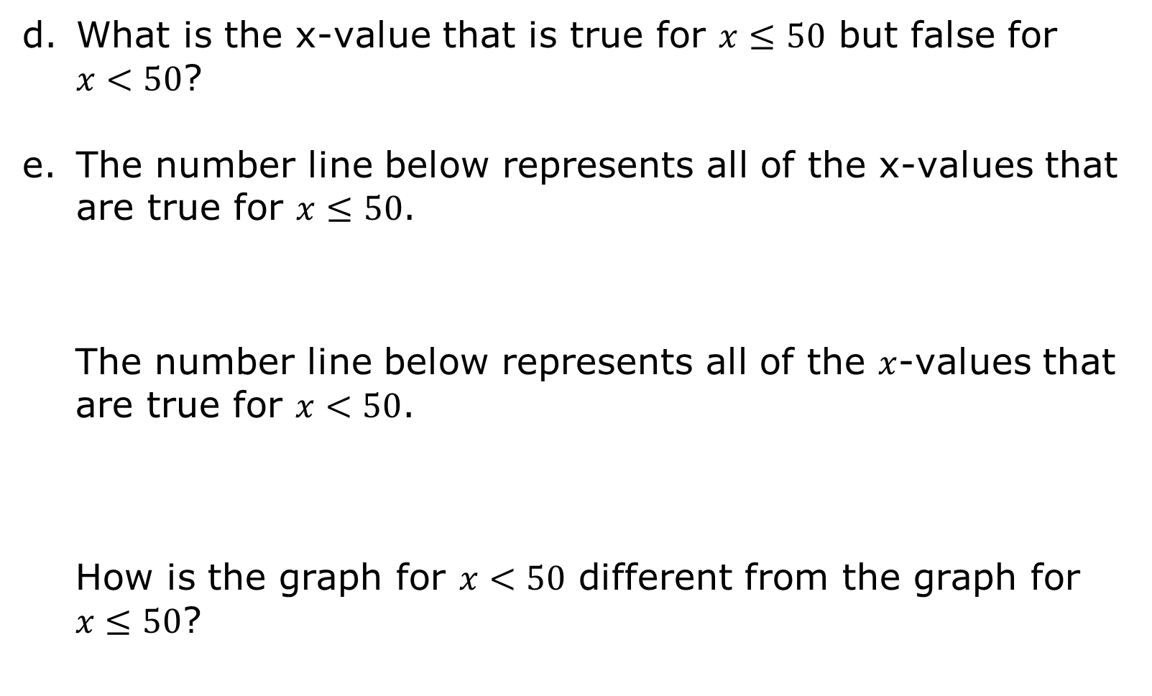
What is the x-value that is true for $x≤50$ but false for $x<50$?
The number line below represents all of the x-values that are true for $x≤50$.
The number line below represents all of the $x$-values that are true for $x<50$.
How is the graph for $x<50$ different from the graph for $x≤50$?
volume 2, pg. 336

Slide 10
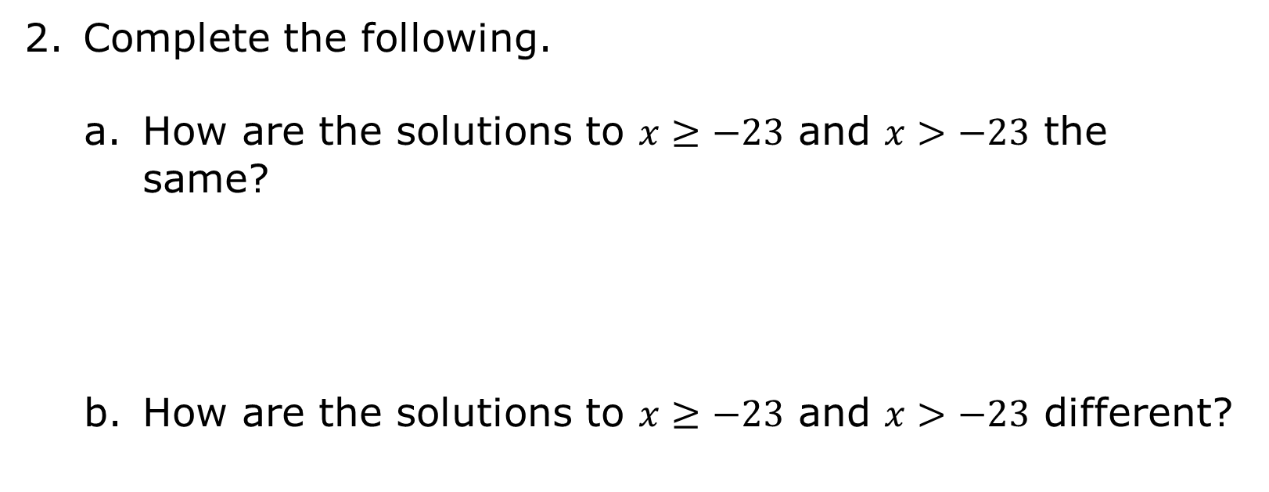
Complete the following.
How are the solutions to $x≥−23$ and $x>−23$ the same?
How are the solutions to $x≥−23$ and $x>−23$ different?
volume 2, pg. 336

Slide 11

Graph the solutions to each inequality on the number lines.
$$x≥−23$$
$$x>−23$$
volume 2, pg. 336

Slide 12
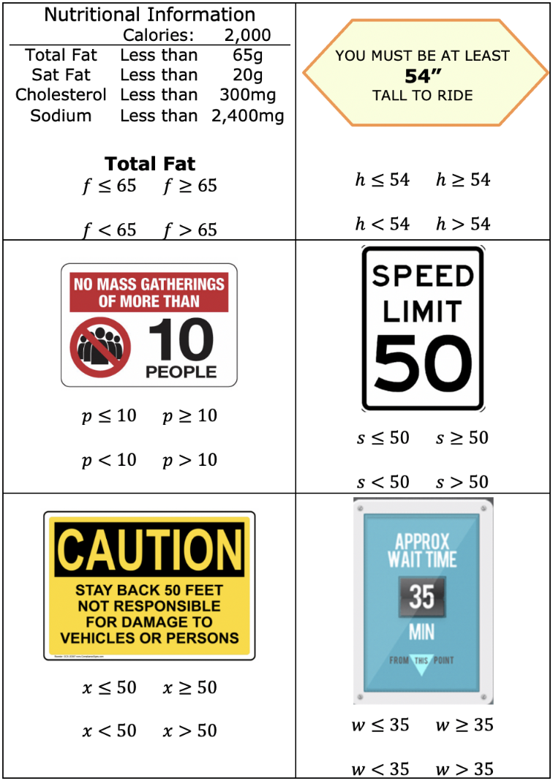
Complete the following.
With your partner, determine which inequality best represents each context.
volume 2, pg. 337

Slide 13
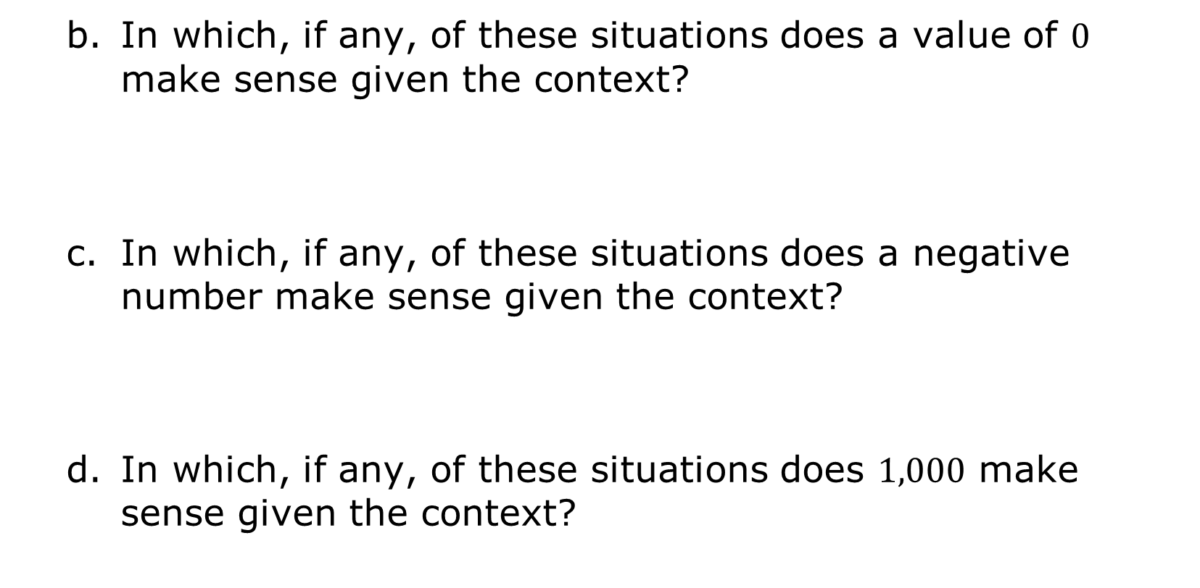
In which, if any, of these situations does a value of $0$ make sense given the context?
In which, if any, of these situations does a negative number make sense given the context?
In which, if any, of these situations does $1,000$ make sense given the context?
volume 2, pg. 337

Slide 14

Guided Practice
volume 2, pg. 338

Slide 15

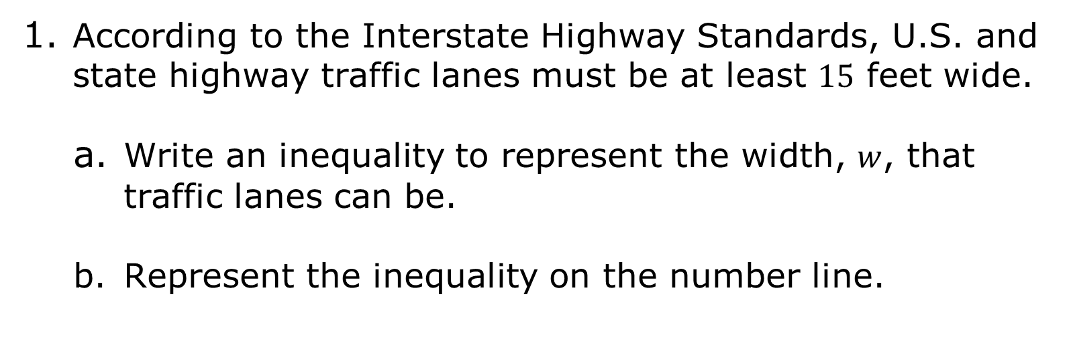
14.1.3 Guided Practice: Translating a Written Description into an Algebraic Inequality
According to the Interstate Highway Standards, U.S. and state highway traffic lanes must be at least $15$ feet wide.
Write an inequality to represent the width, $w$, that traffic lanes can be.
Represent the inequality on the number line.
volume 2, pg. 338

Slide 16
List two examples of possible widths, in feet, for the traffic lane.
Give one example of a width that is true for the inequality but does not make sense in the real world.
volume 2, pg. 338

Slide 17
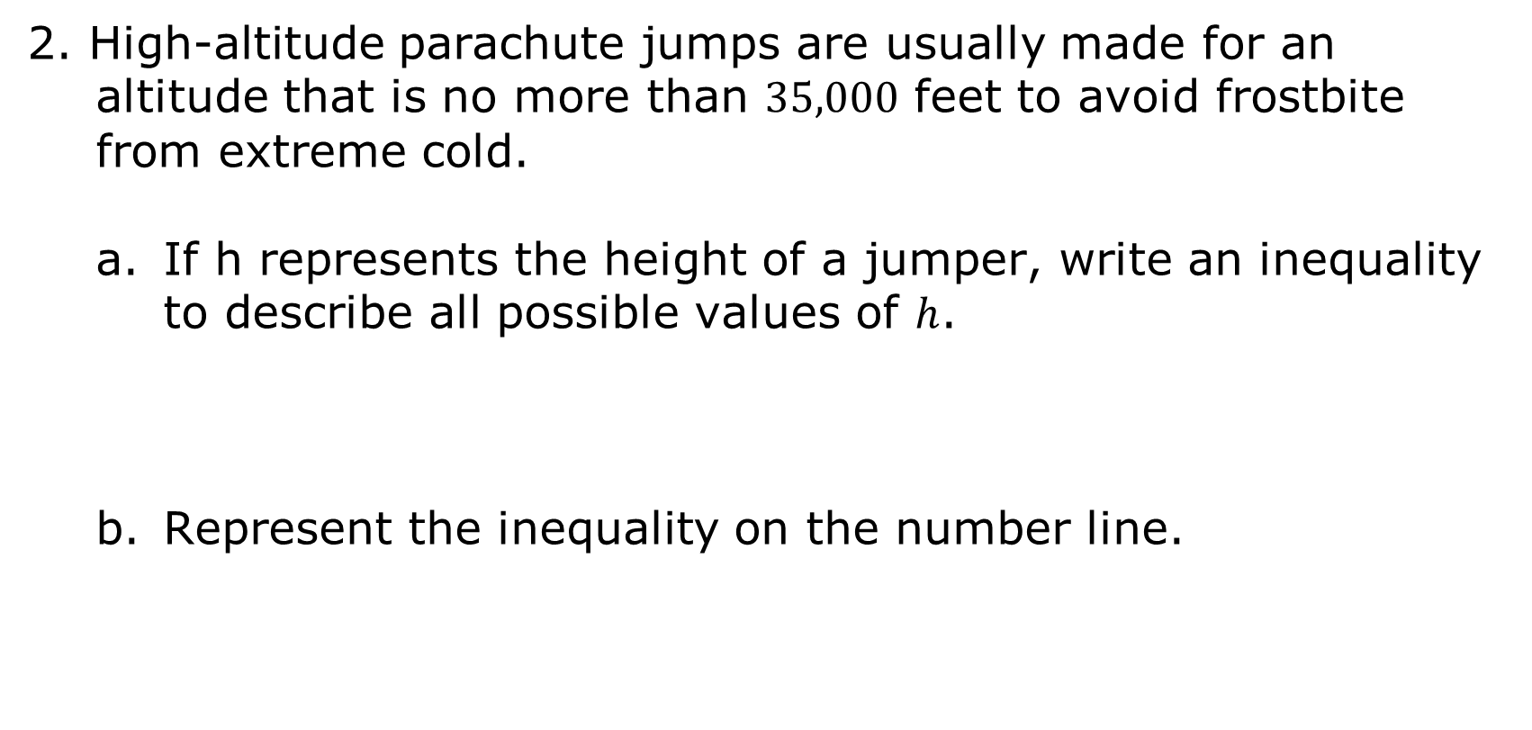
2. High-altitude parachute jumps are usually made for an altitude that is no more than $35,000$ feet to avoid frostbite from extreme cold.
If h represents the height of a jumper, write an inequality to describe all possible values of $h$.
Represent the inequality on the number line.
volume 2, pg. 338

Slide 18
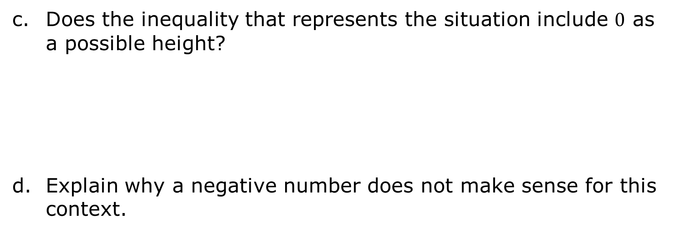
Does the inequality that represents the situation include $0$ as a possible height?
Explain why a negative number does not make sense for this context.
volume 2, pg. 338

Slide 19

Try It
volume 2, pg. 339

Slide 20

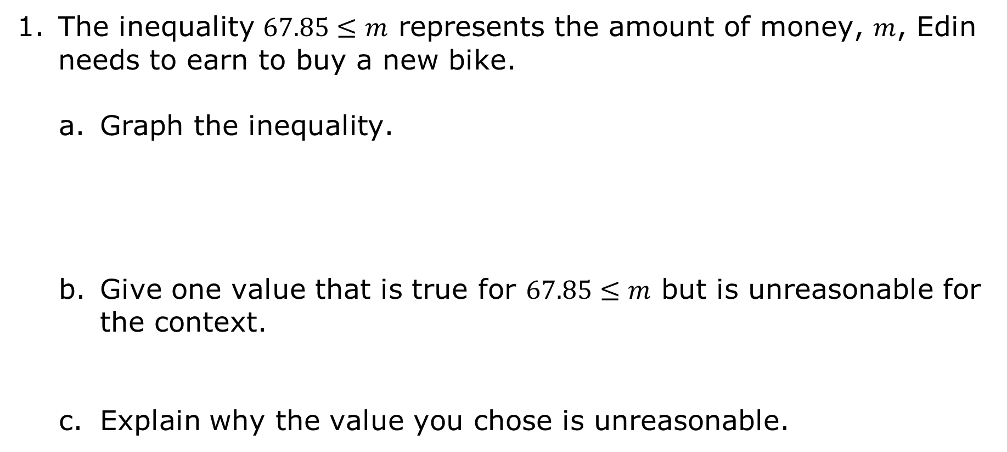
14.1.4 Try It: Writing an Algebraic Inequality and Representing It on a Number Line
The inequality $67.85≤m$ represents the amount of money, $m$, Edin needs to earn to buy a new bike.
Graph the inequality.
Give one value that is true for $67.85≤m$ but is unreasonable for the context.
Explain why the value you chose is unreasonable.
volume 2, pg. 339

Slide 21
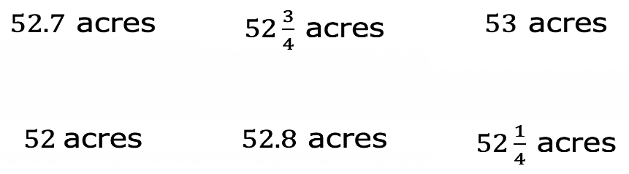
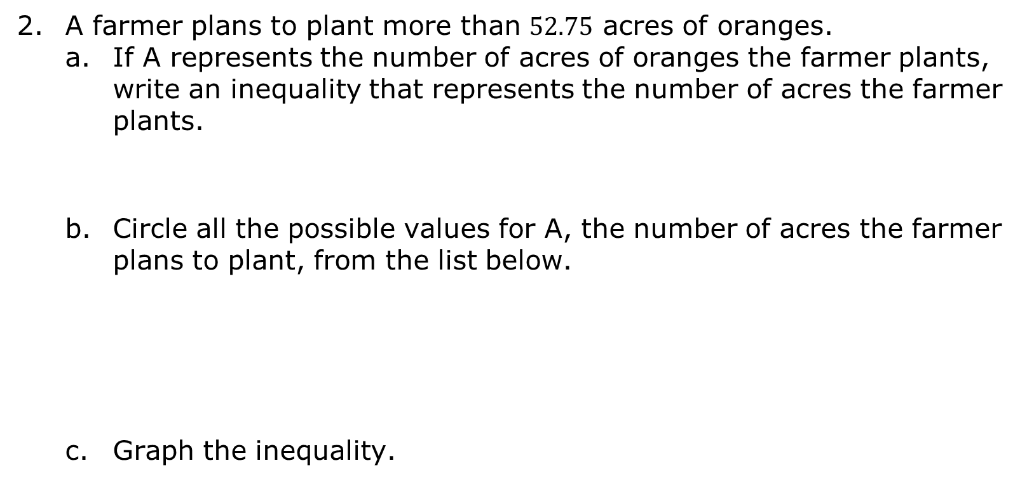
A farmer plans to plant more than $52.75$ acres of oranges.
If A represents the number of acres of oranges the farmer plants, write an inequality that represents the number of acres the farmer plants.
Circle all the possible values for A, the number of acres the farmer plans to plant, from the list below.
Graph the inequality.
volume 2, pg. 339

Slide 22

Your Turn
volume 2, pg. 340

Slide 23
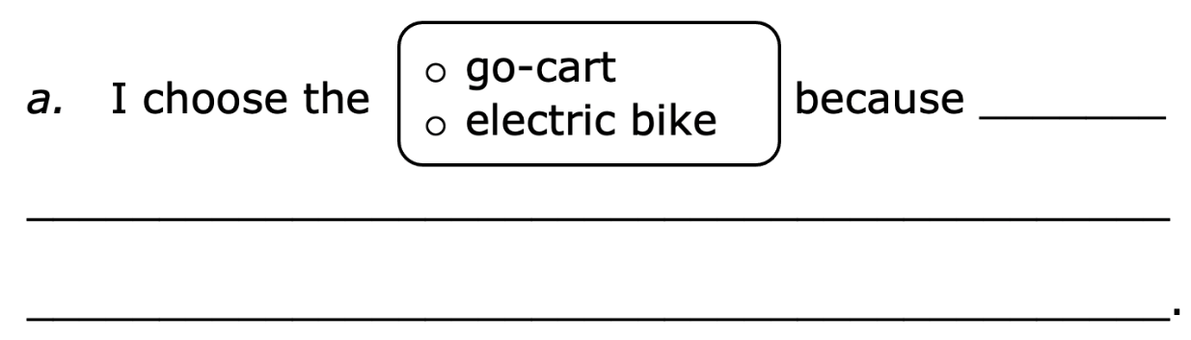
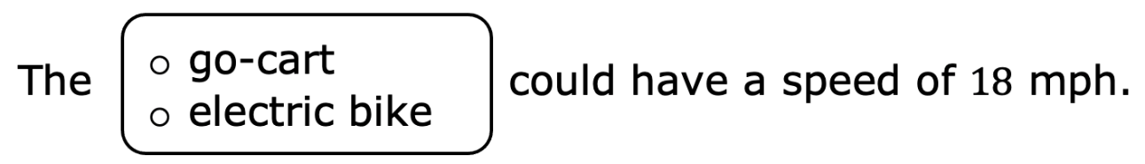
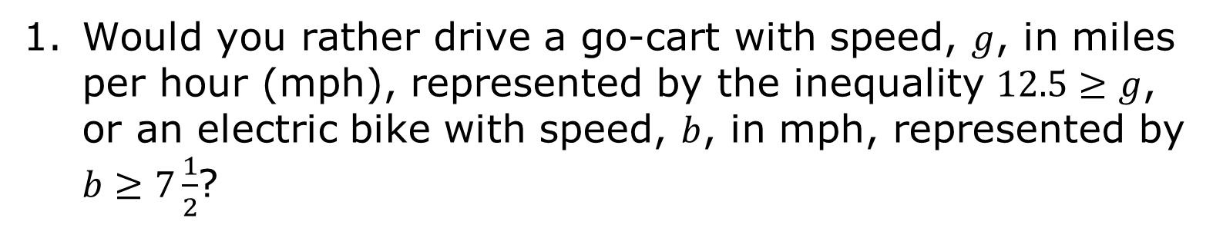
14.1.5 Your Turn!
Would you rather drive a go-cart with speed, $g$, in miles per hour (mph), represented by the inequality $12.5≥g$, or an electric bike with speed, $b$, in mph, represented by $b≥7\frac{1}{2}$?
volume 2, pg. 340

Slide 24
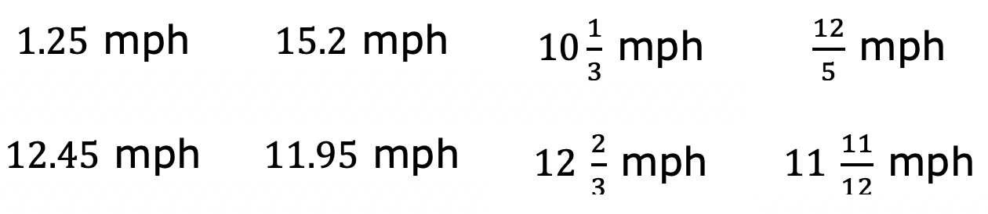
Circle all the values from the list below that are possible speeds for the go-cart.
volume 2, pg. 340

Slide 25
Represent the speed of the electric bike on the number line.
Represent the speed of the go-cart on the number line.
Explain why the number lines do not include negative numbers.
volume 2, pg. 340

Slide 26

Wrap-Up
volume 2, pg. 341

Slide 27
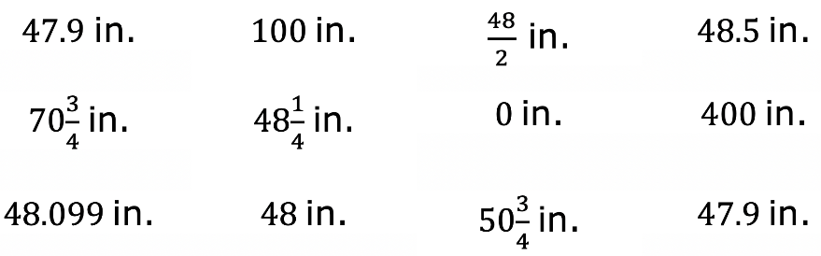
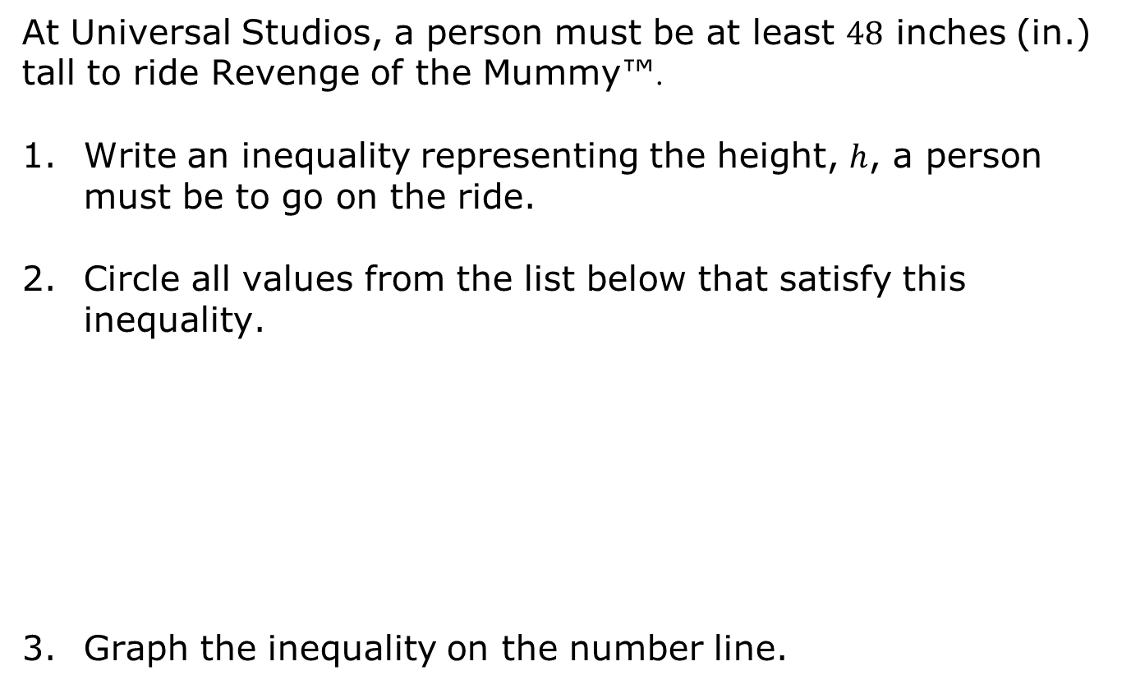
14.1.6 Wrap-Up: Ticket Out the Door
At Universal Studios, a person must be at least $48$ inches (in.) tall to ride Revenge of the Mummy™.
Write an inequality representing the height, $h$, a person must be to go on the ride.
Circle all values from the list below that satisfy this inequality.
Graph the inequality on the number line.
volume 2, pg. 341

